Slide 1

StreamLab
Code Academy AB101
Presented By Tural Asadli

Slide 2
Main Pages
Home
Movies
TvShows
Register
Categories
Contact Us
Log in
Movie Playlist
TvShow Playlist
Buy Subscribe
Search

Slide 3
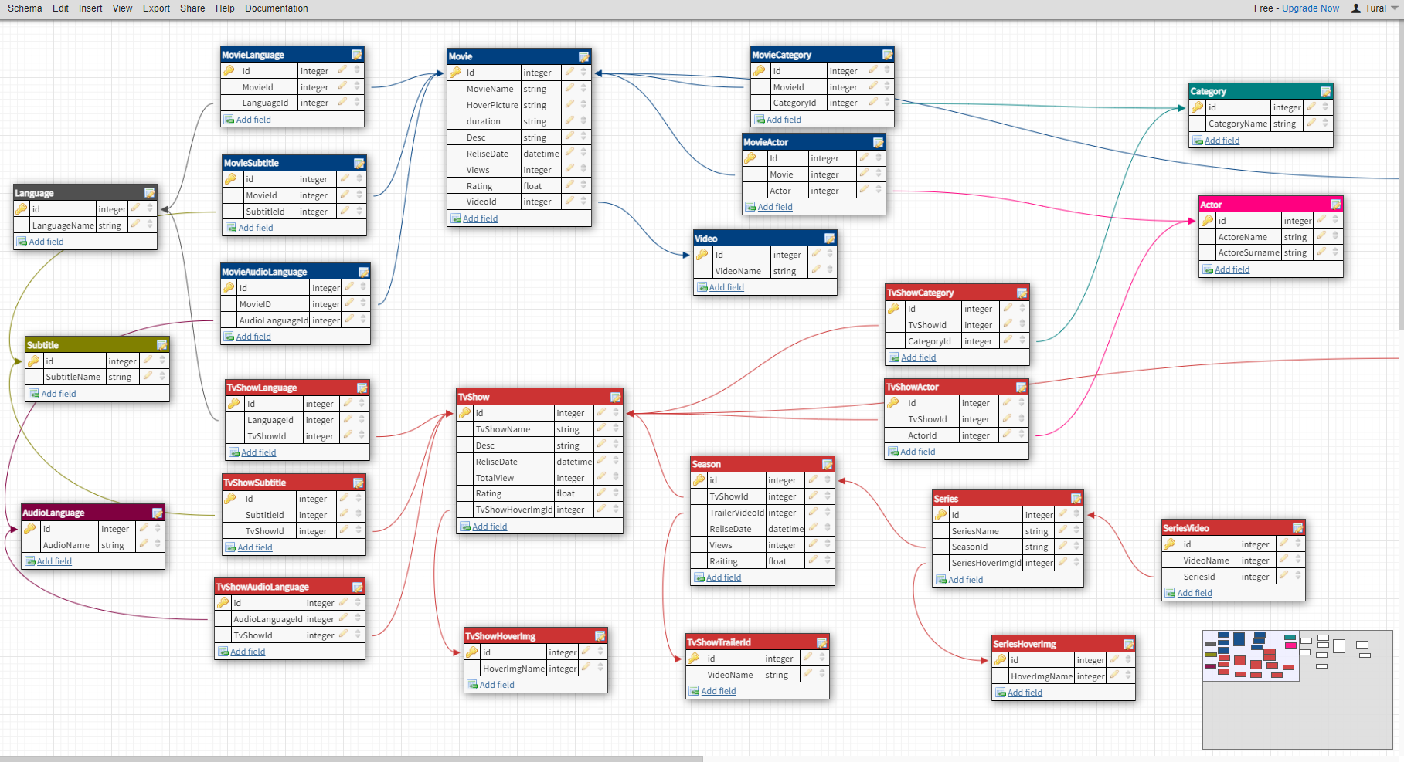
Db Design(Movie and TvShow)

Slide 4
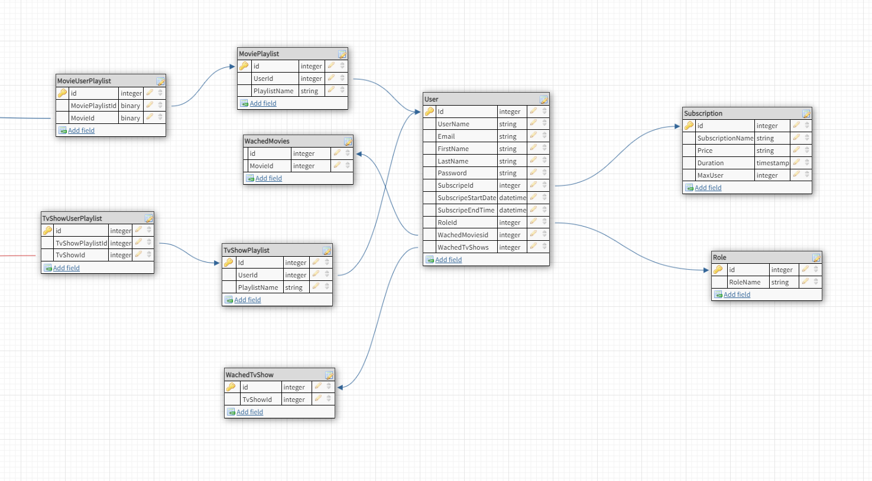
DbDesing(User)

Slide 5
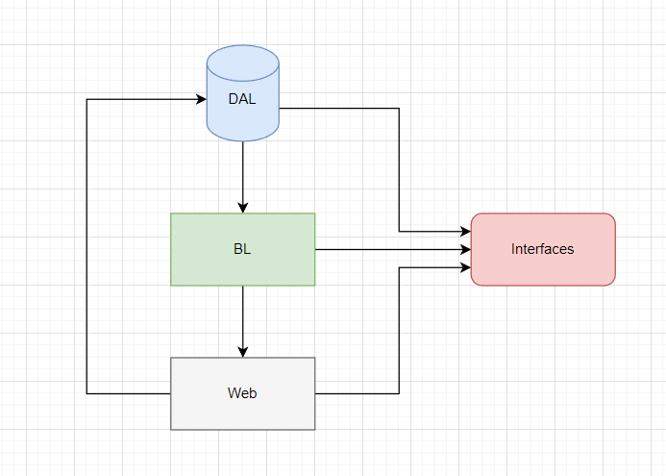
N-Tier
1 - Interfaces (Class library, entities's interfaces);
2 - DAL (Class library and Context);
3 - BL (Class library, Business logic, references the two projects above 1 and 2);
4 - Web (ASP.NET MVC application, Presentation Layer, references two projects 1 and 3);

Slide 6
Admin Panel
Categories
Actors
Languages
Subtitles
Audio Languages
Movies
TvShows
Seasons
Series
Subscribe

Slide 7
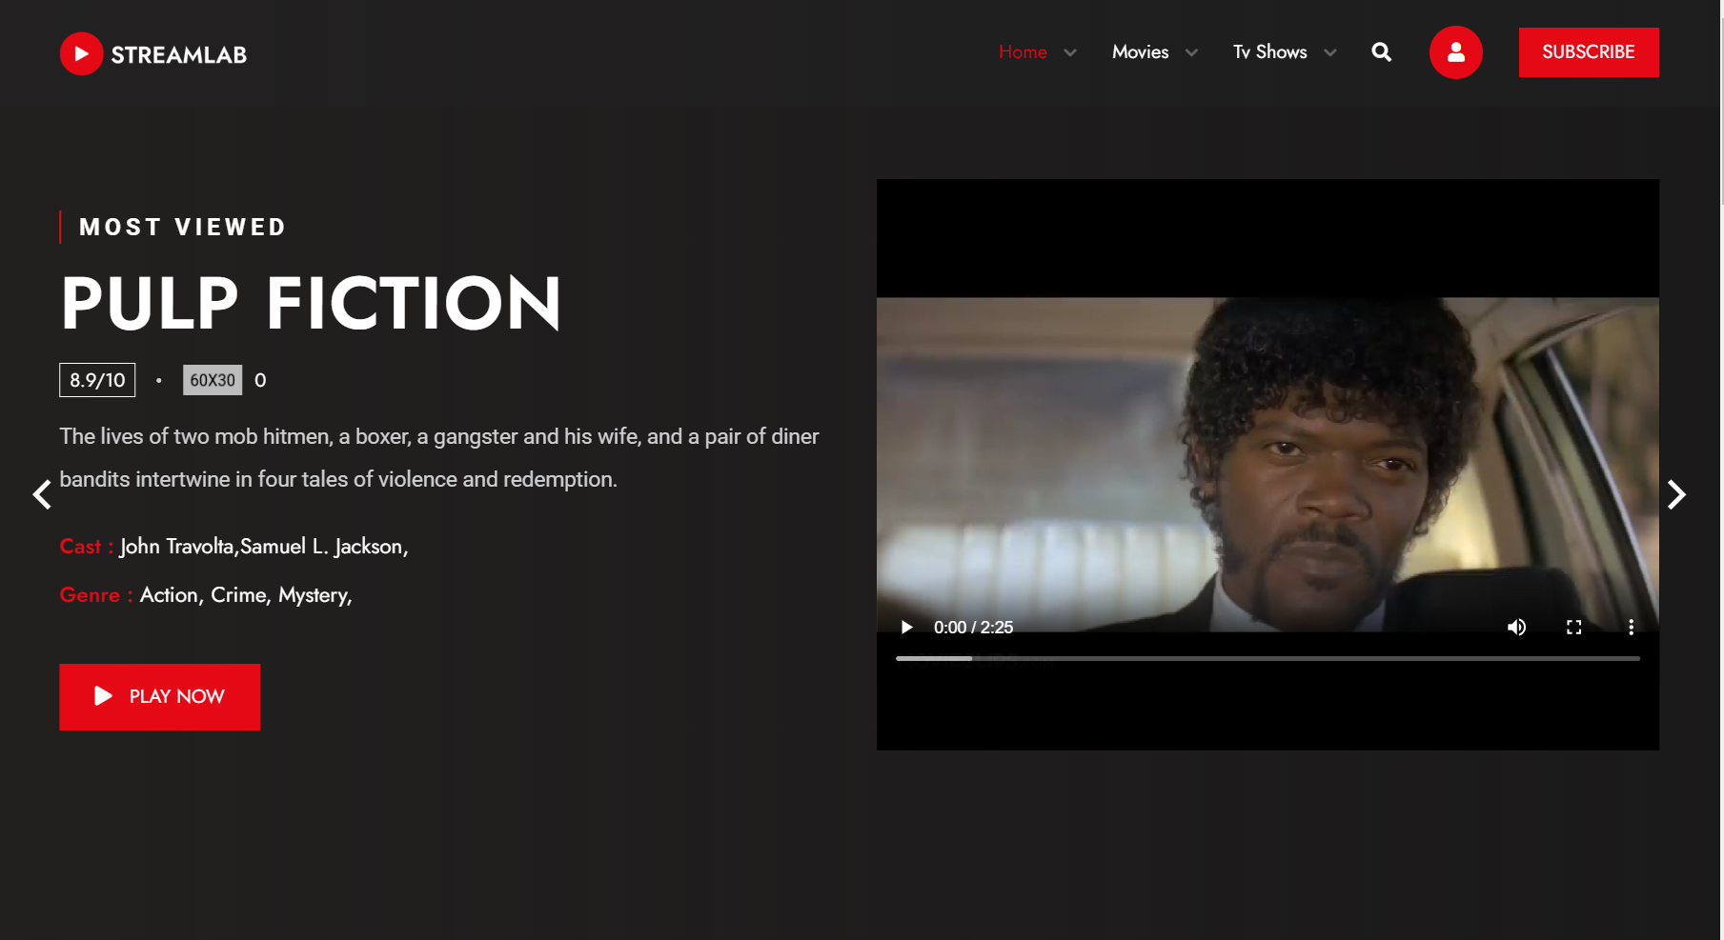
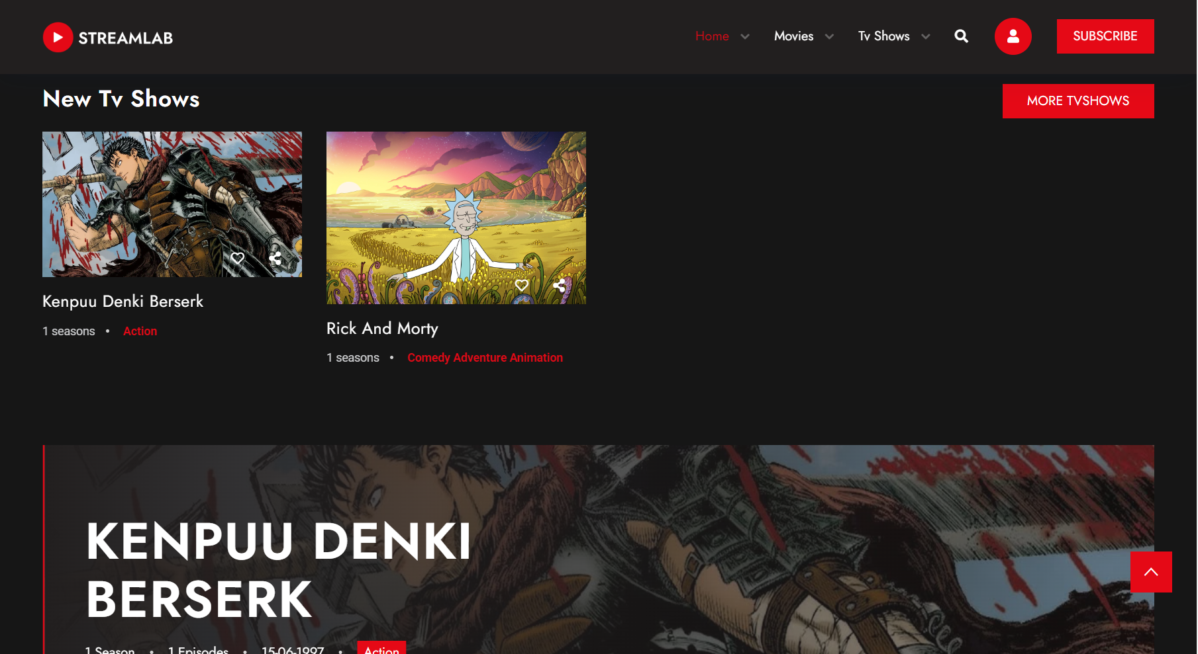
Movies
Language
Subtitles
Audio Languages
Genre
Run Time
Release Date

Slide 8
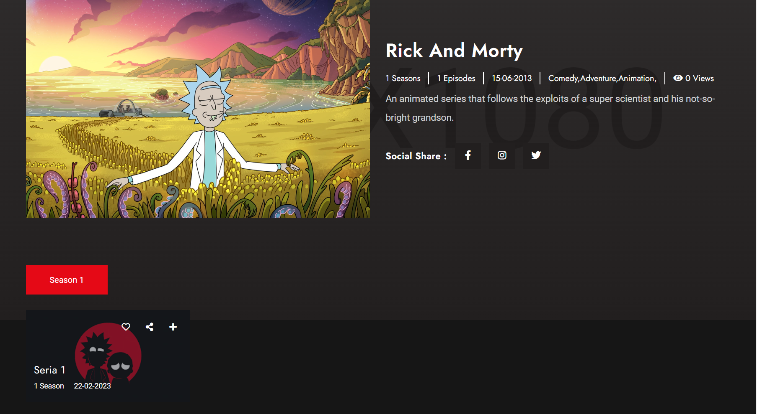
TvShow
Seasons
Relies Date
Categories
Views
Description
Episodes list

Slide 9
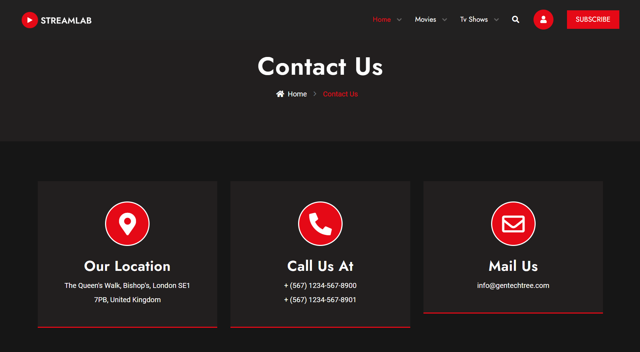
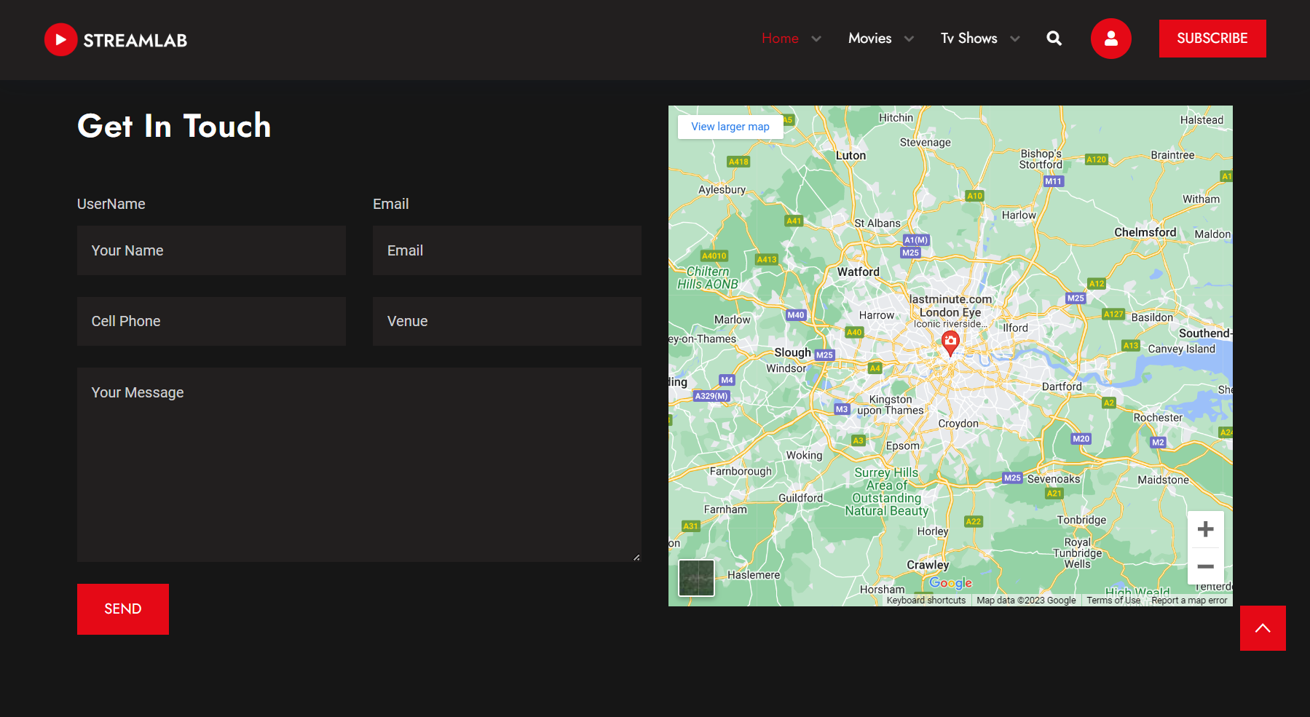
Settings
Feedbacks
Location
Firstname
Secondname
Email

Slide 10
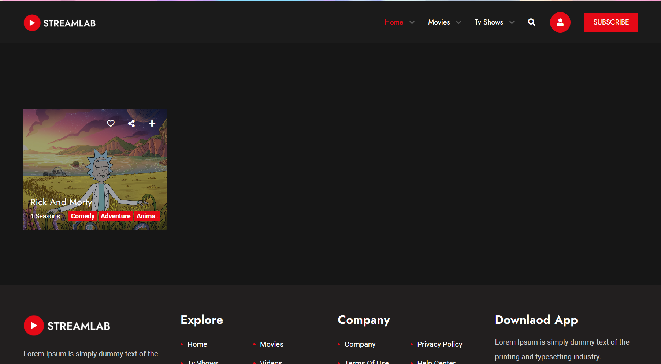
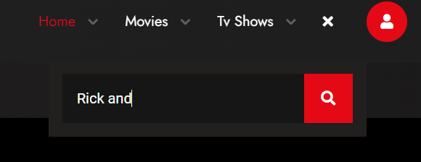
Search System

Slide 11
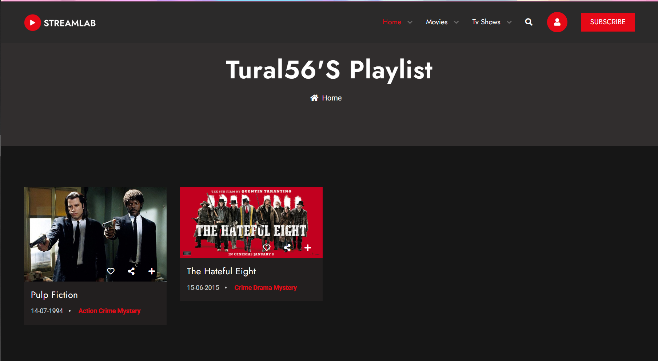
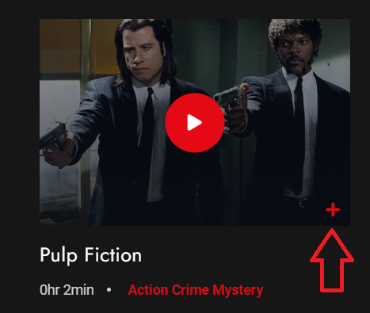
User MoviePlaylist

Slide 12
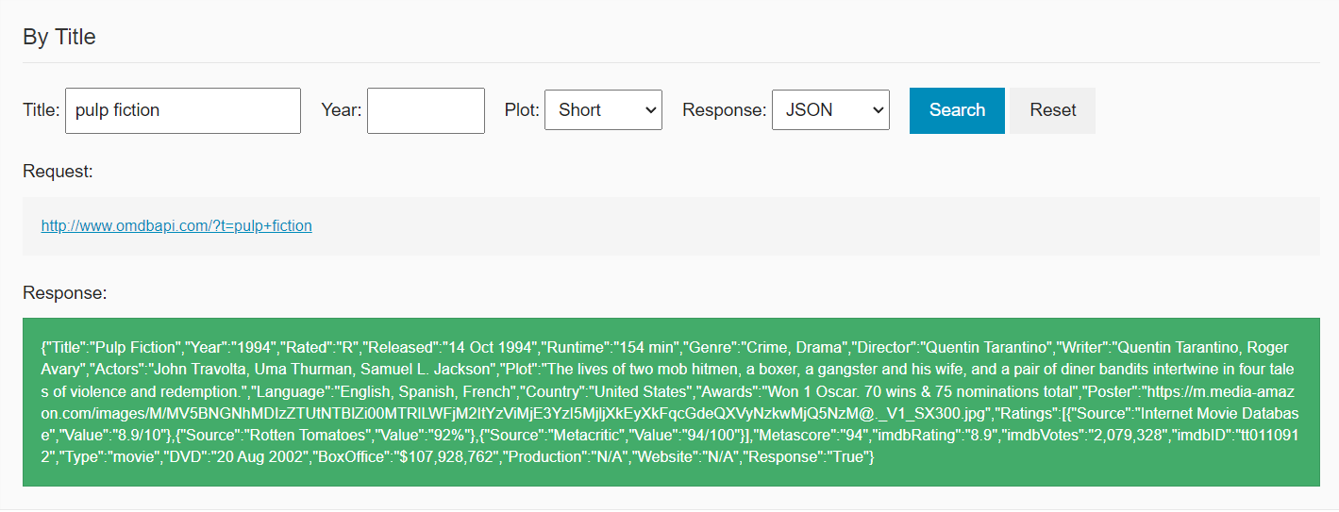
OMDb API
Title, Year, Rated, Released, Runtime, Genre, Director, Writer, Actors, Plot, Language, Country, Awards, Poster, Ratings, Metascore, imdbRating, imdbVotes, Type, DVD, BoxOffice, Production, Website, Response
Rating:
Source, Value

Slide 13
NReco Library
NReco.VideoConverter is a library that provides a wrapper around the FFmpeg multimedia framework, allowing developers to easily perform video and audio conversion, editing, and processing tasks.
To get the duration of a video using NReco.VideoConverter, you can use the GetMediaInfo method of the FFProbe class.

Slide 14
Thank you for your attention

